Slide 1

The Sparks Foundation
Graduate Rotational Internship Programme
#GRIPMAY21

Slide 2
Domain
Task
Done By
Web Designing &
Development
Basic Banking
System
Deepa Harish

Slide 3
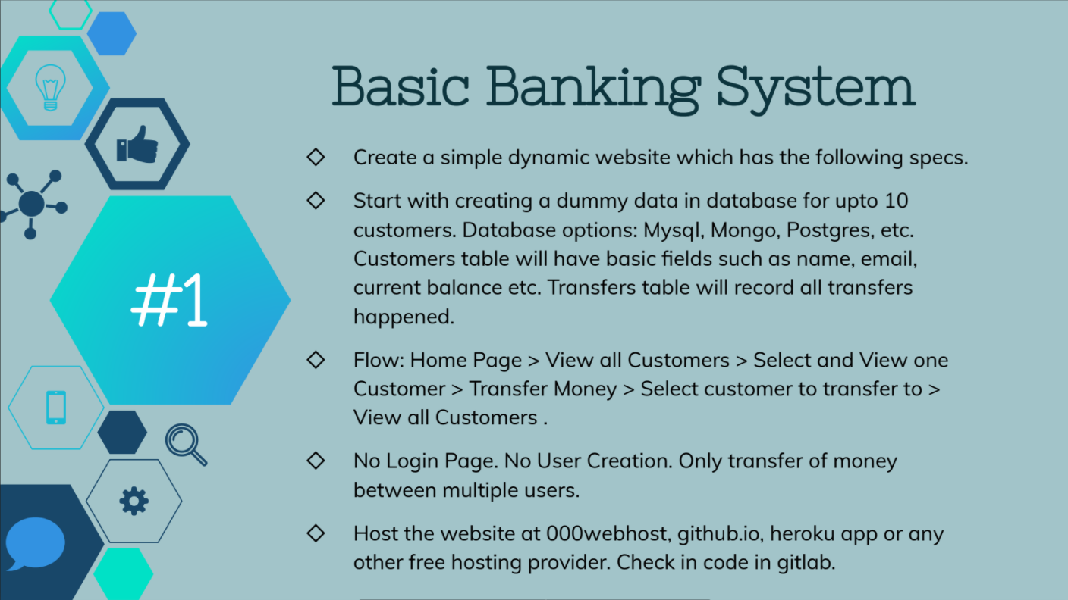

Slide 4
Thanks!
Github Link: https://github.com/deepaharish22/Basic-Banking-System
Project Link: https://thetransact.000webhostapp.com/

